Slide 1


Repo Alert Monitor
November 2020
Supervised by – Mrs. Ines Slimen
Mrs. Maroua Hddad
Mr. Walid Frikha
Created by – Mouafek Ayadi

Slide 2
Table of Contents
03
05
08
Overview
Challenges and Solution
Needs Specification
15
15
15
Conception
Integration
Conclusion and Perspectives

Slide 3
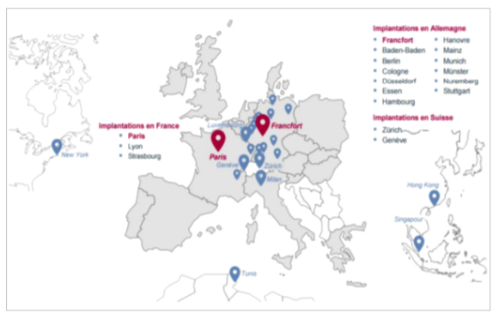
Overview: The Company
ODDO BHF is an independent Franco-German financial services group.
ODDO BHF operates in Private Banking, Asset Management and Corporate and Investment Banking.
ODDO BHF has geographical presence all around the world, mainly in France and Germany.
Sources: Oddo BHF.

Slide 4
Overview: The project
The Fixed Income department within the ODDO BHF group, deals with many securities divided into two major categories (Equities and Bonds), and each has its own derivatives.
Report Alert Monitor is an alert system for notifying ODDO BHF Fixed Income department about daily Abnormal market movements, hosted in a website.
The website has dynamic dashboards that analyze daily financial transactions, which gives an overview on the market movements.
Sources: Oddo BHF.

Slide 5
The Challenges
Traditional tools are not made for spotting abnormal market movements, and using them for automating daily analytics is not a convenient task.
Detecting anomalies in financial transactions manually takes days and weeks and it does not include all the data, which affect the decision making.
Absence of an end to end pipeline that goes from processing the raw data, to producing anomalies alert system and insightful dashboards for analytics.
Sources: Oddo BHF.
Notes:
No existing solution

Slide 6

Solution: The Architecture
DATA
SQL SERVER
DJANGO
DASHBOARDS
AI MODELS
ALERTS
RPA
Equities
Bonds
DATA
DAILY EXCEL UPDATE
Sources: Oddo BHF.

Slide 7
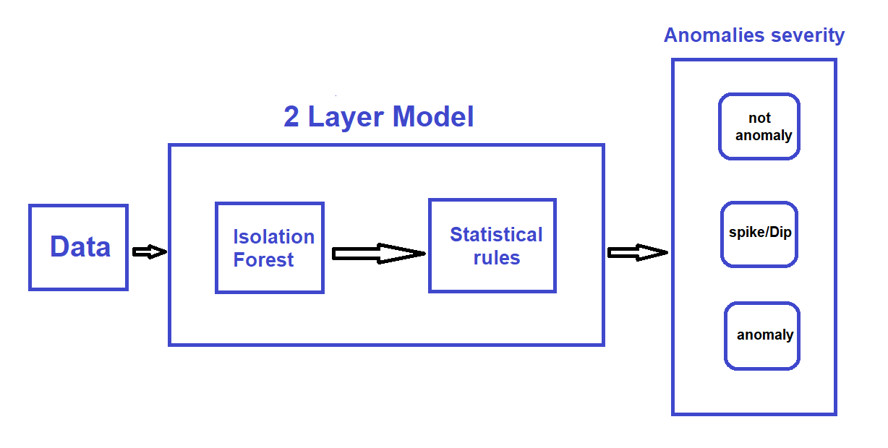
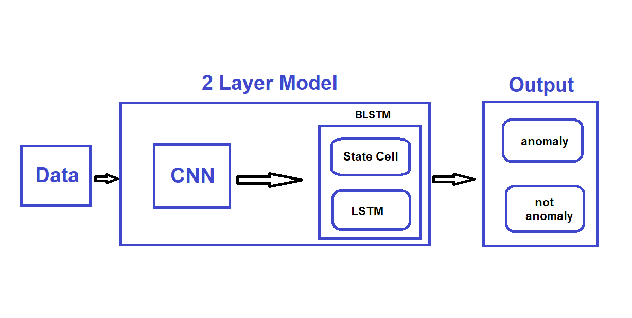
Solution: Artificial Intelligence Models
Machine Learning Model for Bonds
Deep Learning Model for Equities
Sources: Oddo BHF.

Slide 8
Needs Specification: Functional needs
Perform automatized ETL on data
Search for specific data
Visualize alerts of anomalous data
Visualization of data Analysis
Manually Add and remove users

Slide 9
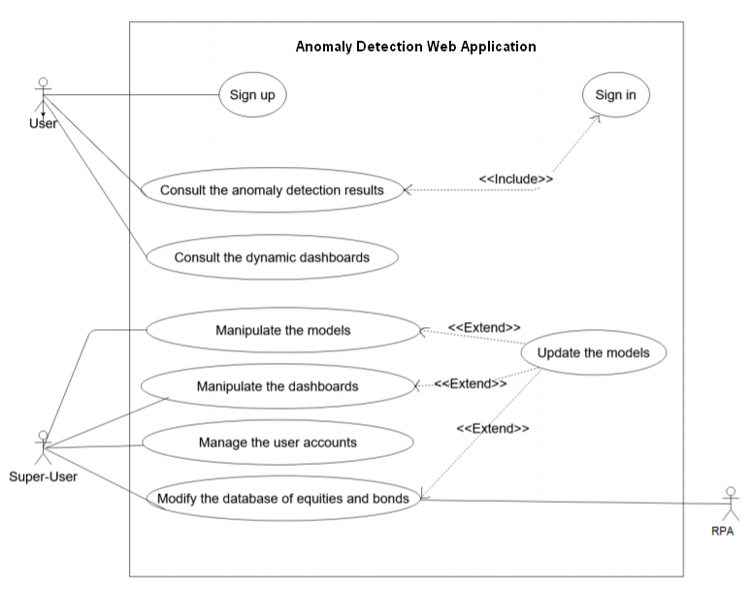
Needs Specification: Use Case

Slide 10
Needs Specification: Actors Identification
Admin: control and manage the Website Analyst: use the platform services

Slide 11
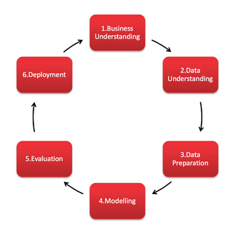
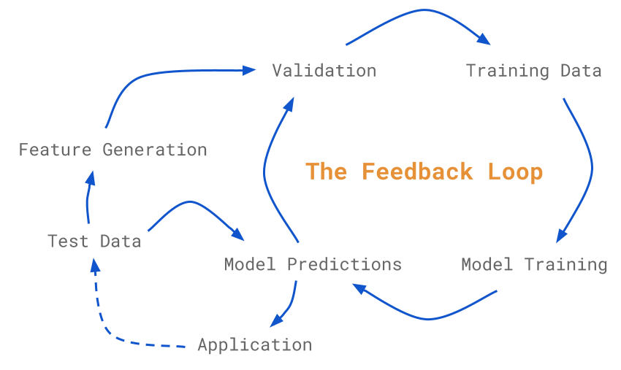
Conception: CRISP-DM
Approach used for developing AI models

Slide 12
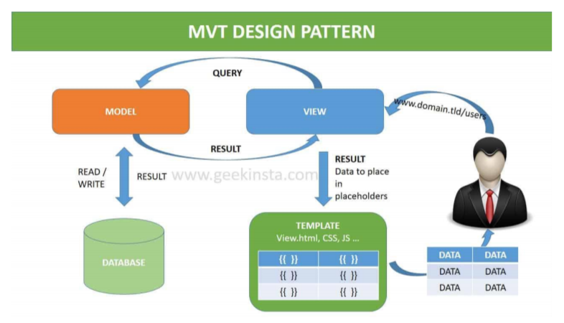
Conception: MVT
DP used for developing the Django Website

Slide 13
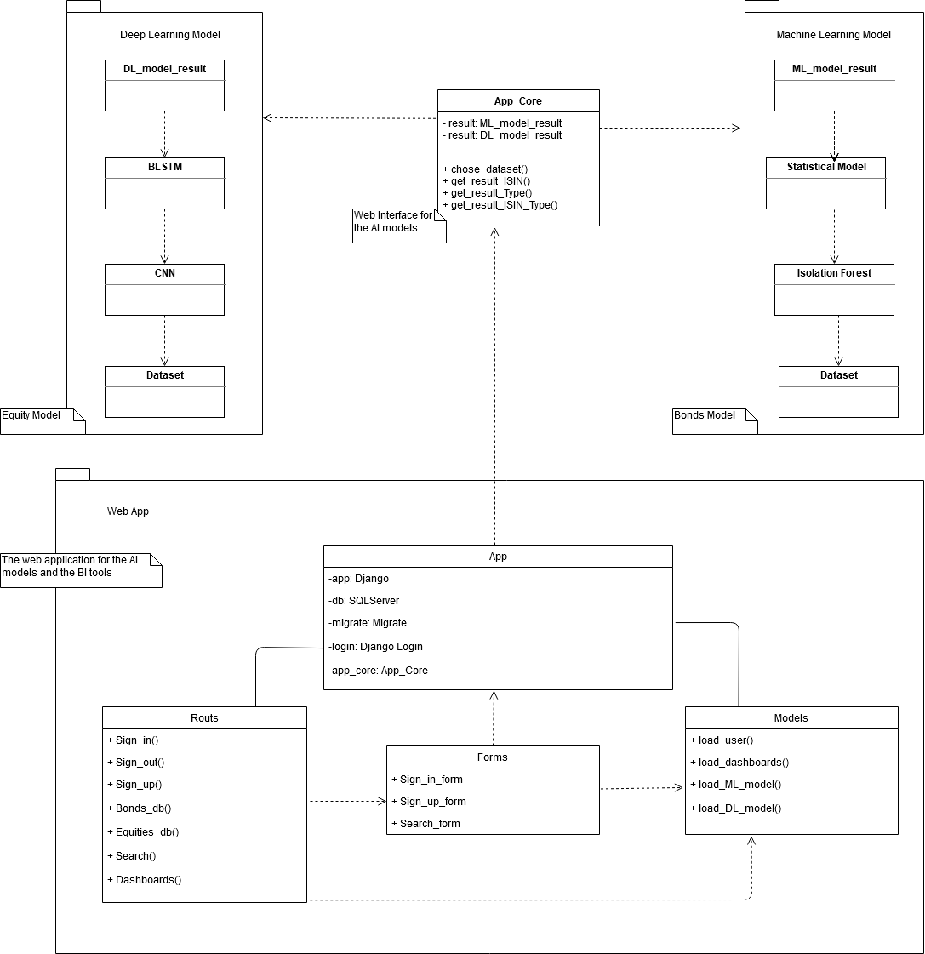
Conception: Class Diagram

Slide 14
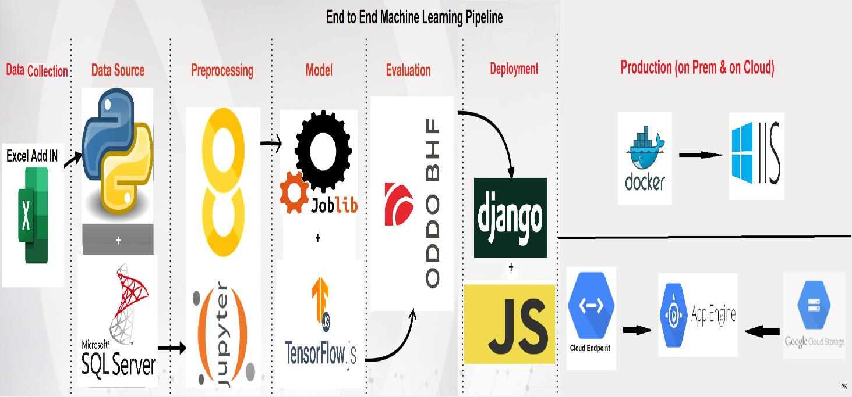
Integration: End to End ML Pipeline

Slide 15
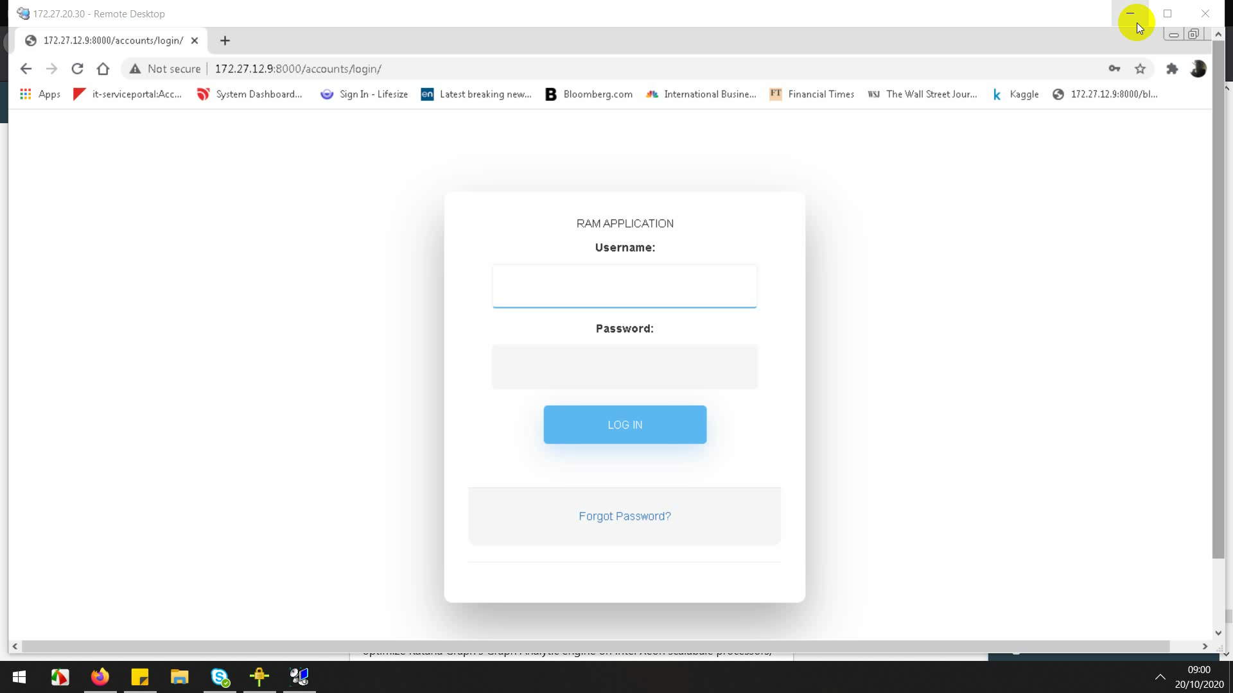
Integration: Execution Scenario

Slide 16
Conclusion and Perspectives

